Slide 1
Api routes
html routes
data
home
home
survey
survey
survey data
characters
add
character data
search
search
search data
friends data

Slide 2
Q1: You have a Dragon Tattoo?
NeverYY
No
Thinking About it
Yes
Have more than 1
Q2: You love hunting
No
Not really
No preference
Maybe
Yes
Q3: What color do you prefer?
Red
Green
White
Blue
Black
Q4: What superhero do you prefer?
Iron Man
Captain America
Snowflake
Wonder Woman
Captain Marvel
Q5: What would you rather do in your free time?
Go for a hike
Curl up on the couch and watch Tv
Work on arts and crafts
Curl up on the couch and read a book
Manage your money
Q1: What type of movie do you like to watch?
Adventure
Suspense
Horror
Romantic Comedy
Comedy
Q2: What detective show do you prefer?
Bones
NCIS
Murder She Wrote
Law and Order
Sherlock
Q3: What Fantasy movie would you prefer to watch?
Harry Potter
The Hobbit
Game of Thrones
Pete’s Dragon
Mulan
Q4: What type of trait do you prefer?
Funny
Intelligent
Protector
Frugal
Free Spirit
Q5: Where would you prefer to live?
Pacific Northwest
Asia
Atlantic Northeast
Europe
Pacific Southwest
Q1: What type of movie do you like to watch?
Adventure
Suspense
Horror
Romantic Comedy
Comedy
Q2: What detective show do you prefer?
Bones
NCIS
Murder She Wrote
Law and Order
Sherlock
Q3: What Fantasy movie would you prefer to watch?
Harry Potter
The Hobbit
Game of Thrones
Pete’s Dragon
Mulan
Q4: What type of trait do you prefer?
Funny
Intelligent
Protector
Frugal
Free Spirit
Q5: Where would you prefer to live?
Pacific Northwest
Asia
Atlantic Northeast
Europe
Pacific Southwest
Dragon Tatto
Hunting
Color
Superhero
Free Time
Movie type
Detective Show
Fantasy Movie
Trait
Live
Norwegian Ridgeback [1,1,1,1,1,1,1,1,1,1]
Chinese Fireball
Ukranian Ironbelly
Hungarian Horntail
Smaug
Night-fury
Puff
Petes Dragon
Drogon
Mushu

Slide 3
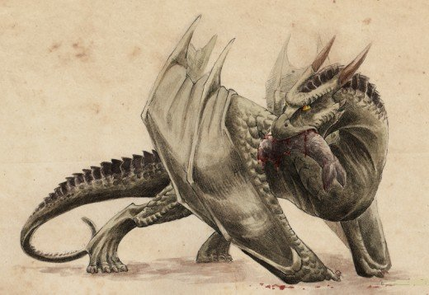
Norwegian Ridgeback
Score:
Q1: You have a Dragon Tattoo? 3
Q2: You love hunting? 5
Q3: What color do you prefer? 2
Q4: What superhero do you prefer? 3
Q5: What would you rather do in your free time? 1
Q6: What type of movie do you like to watch? 3
Q7: What detective show do you prefer? 1
Q8: What Fantasy movie would you prefer to watch? 1
Q9: What type of trait do you prefer? 5
Q10: Where would you prefer to live? 2
Score: [3,5,2,3,1,3,1,1,5,2]
Average Size: Unknown
Ridgebacks don't have an official size, but they'red noted to resemble Hungarian Hornbacks, who measure at a fierce 50 feet. Hagrid's baby dragon, Norbert (later revealed to be a female and dubbed Norberta) belongs to this species. Ridgebacks aren't as hostile as some dragons, but they bear venomous fangs, prefer hunting large mammals, and develop the ability to shoot flames earlier than any other species.
The Ridgeback's name likely references the infamous lion-hunting Rhodesian Ridgeback dog breed, a fitting metaphor considering the troubles Norbert causes Harry and friends (who belong to lion-themed Gryffindor).
Ridgebacks aren't as hostile as some dragons, but they bear venomous fangs, prefer hunting large mammals, and develop the ability to shoot flames earlier than any other species.
https://hobbylark.com/fandoms/best-harry-potter-dragon-species

Slide 4
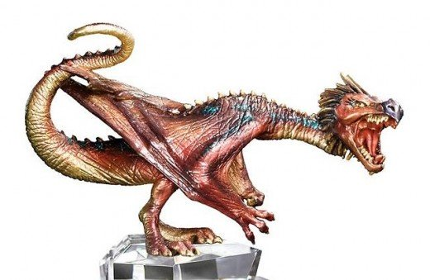
Score:
Q1: You have a Dragon Tattoo? 5
Q2: You love hunting? 3
Q3: What color do you prefer? 4
Q4: What superhero do you prefer? 1
Q5: What would you rather do in your free time? 5
Q6: What type of movie do you like to watch? 2
Q7: What detective show do you prefer? 5
Q8: What Fantasy movie would you prefer to watch? 1
Q9: What type of trait do you prefer? 2
Q10: Where would you prefer to live? 2
Score: [5, 3,4,1,5,2,5,1,2,2]
Chinese Fireball Dragon
https://www.wizardingworld.com/features/pottermore-guide-to-dragons
Victor Krum's opponent in the first Triwizard task, Chinese Fireballs aren't exceptionally large, but they're aggressive monsters sometimes called Liondragons (need a new mascot, Gryffindor?).
Fireballs are easily angered, and they're noted to be surprisingly agile and clever; some are even willing to share territory with up to two kin, occasionally even cooperating to take down larger threats. In the movie, Barty Crouch Sr.'s reaction to Krum drawing the Fireball implies he considers the Fireball to be the second-deadliest of the four dragons used for the competition.
Although similar in appearance, in Chinese myths, dragons were often more benevolent than their Western counterparts. Chinese dragons are a symbol of good fortune, representing a path to enlightenment.

Slide 5
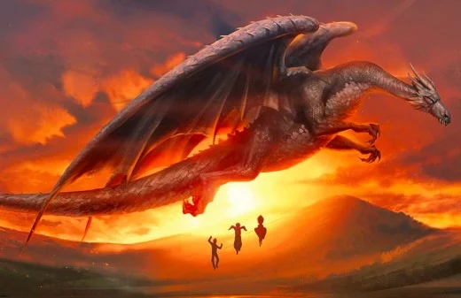
Score:
Q1: You have a Dragon Tattoo? 3
Q2: You love hunting? 2
Q3: What color do you prefer? 2
Q4: What superhero do you prefer? 2
Q5: What would you rather do in your free time? 2
Q6: What type of movie do you like to watch? 2
Q7: What detective show do you prefer? 3
Q8: What Fantasy movie would you prefer to watch? 1
Q9: What type of trait do you prefer? 5
Q10: Where would you prefer to live? 4
Score: [3,2,2,2,2,2,3,1,5,4]
2. Ukrainian Ironbelly
Average Size: 60 ft
The largest of all dragons, Ukrainian Ironbellys possess scales as strong as steel and produce scorching flames, though they're notably slower in flight compared to other species. The goblins of Gingotts Bank employed an Ironbelly to guard their vault, though it eventually escaped in the aftermath of our heroes' infiltration during Deathly Hallows.
In Fantastic Beasts and Where to Find Them, Newt Scamander mentions he previously worked with Ironbellys, which undoubtedly wasn't an easy task.

Slide 6
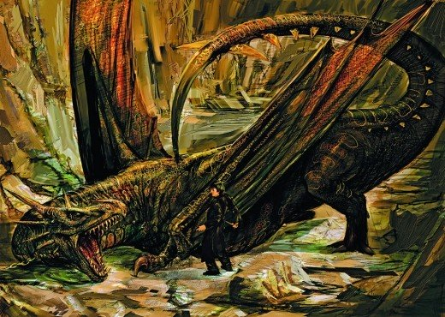
Score:
Q1: You have a Dragon Tattoo? 4
Q2: You love hunting? 5
Q3: What color do you prefer? 5
Q4: What superhero do you prefer? 1
Q5: What would you rather do in your free time? 1
Q6: What type of movie do you like to watch? 3
Q7: What detective show do you prefer? 1
Q8: What Fantasy movie would you prefer to watch? 1
Q9: What type of trait do you prefer? 3
Q10: Where would you prefer to live? 5
Score: [3,2,2,2,2,2,3,1,5,4]
Hungarian Horntail Dragon
1. Hungarian Horntail
Average Size: 50 ft
Considered the most dangerous of all dragon types, Hungarian Horntails are large, territorial, agile, and can shoot flames farther than other breeds.
Harry faced one in the Triwizard Tournament, and despite his talents as a Quidditch Seeker and possession of the immensely-fast Firebolt broomstick, the Horntail nearly killed him in their aerial battle.
No doubt about it—with their well-rounded abilities and combative temperament, Horntails are the most dangerous dragons of all.

Slide 7
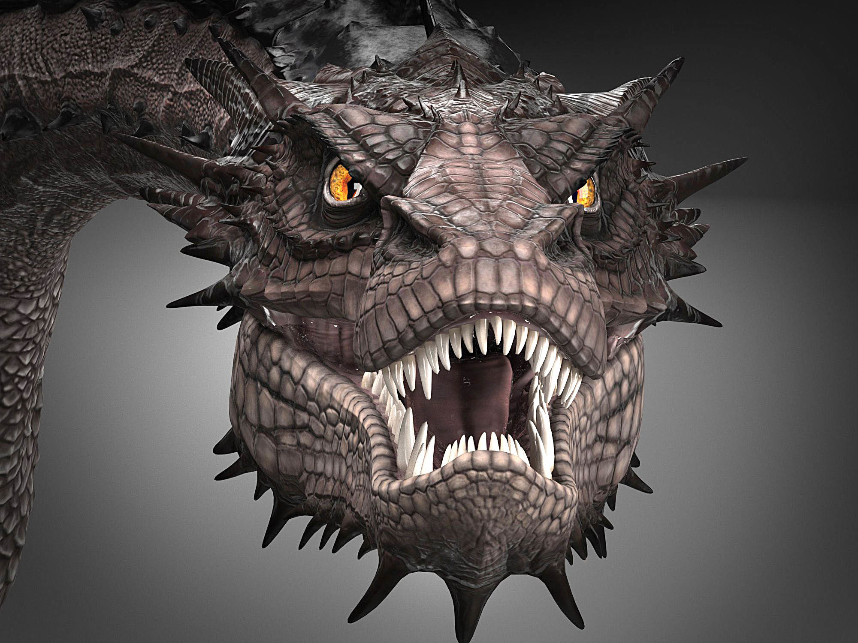
Smaug (/smaʊɡ/) is a dragon and the main antagonist in J. R. R. Tolkien's 1937 novel The Hobbit, his treasure and the mountain he lives in being the goal of the quest. Powerful and fearsome, he invaded the Dwarf kingdom of Erebor 150 years prior to the events described in the novel.
Score:
Q1: You have a Dragon Tattoo? 5
Q2: You love hunting? 5
Q3: What color do you prefer? 5
Q4: What superhero do you prefer? 5
Q5: What would you rather do in your free time? 5
Q6: What type of movie do you like to watch? 2
Q7: What detective show do you prefer? 4
Q8: What Fantasy movie would you prefer to watch? 2
Q9: What type of trait do you prefer? 2
Q10: Where would you prefer to live? 3
Score: [5,5,5,5,5,2,4,2,3]
Other names
During the conversation between Smaug and Bilbo, Bilbo calls him several names and epithets, such as Smaug the:
Golden
Magnificent
Tremendous
Unassessably Wealthy
Mighty
Terrible
Stupendous
Tyrannical
Impenetrable
Chiefest and Greatest of Calamities
Your Magnificence
Smaug's monstrous appearance also belied keen senses and a dangerously sharp mind.
https://static.turbosquid.com/Preview/001234/008/8U/smaug-hobbit-dragon-model_Z.jpg
Personality
Smaug is portrayed as being psychopathic, extremely sadistic, confident, violent, cruel, arrogant, intelligent and greedy, possessing an unquenchable desire for gold. His most distinguishing characteristic (aside from his greed) is his arrogance, as Smaug proudly boasts of his superiority and impregnability to Bilbo during their encounter. However, this proves to be his downfall, as he unwittingly reveals the weak spot in his chest to Bilbo when showing the Hobbit how he had willfully coated his underbelly in treasure to protect it.
Smaug seems primarily motivated by personal greed rather than a desire to do evil, and does not seem to serve any allegiance other than his own. While he does ruthlessly destroy Dale and lays waste to the Dwarves of the Lonely Mountain during his attack on the Lonely Mountain, once he has assumed dominion of the region he seems content to allow the rest of Middle Earth to go about its business, so long as he or his treasure remains undisturbed; although this could be because he feels that the people living in the region have nothing he wants. Highly intelligent, Smaug appears to possess a rather sardonic sense of humor, darkly mocking Bilbo while they converse within the Lonely Mountain's treasure chamber. Smaug seems to despise the Dwarves, considering them to be weak and pathetic creatures far beneath him, making unfavorable comments about Thror and showing no remorse over his slaughter of their kind and claiming of their kingdom. While conversing with Bilbo, Smaug is also able to quickly surmise the reason for Bilbo's presence in Erebor, and also correctly deduces that the Dwarves received aid from the men of Esgaroth in reaching the mountain.

Slide 8
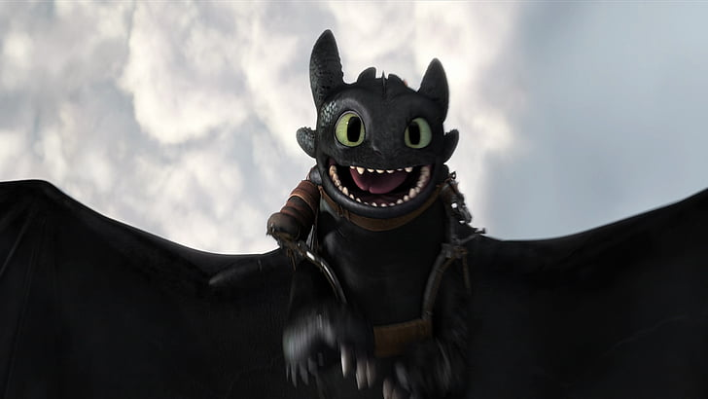
https://www.google.com/url?sa=i&url=https%3A%2F%2Fwww.wallpaperflare.com%2Fmovie-how-to-train-your-dragon-2-toothless-how-to-train-your-dragon-wallpaper-bnhn&psig=AOvVaw0hwJs9lThPLP3ZZwSOTbv1&ust=1587908619777000&source=images&cd=vfe&ved=0CA0QjhxqFwoTCODohdnbg-kCFQAAAAAdAAAAABAD
Score:
Q1: You have a Dragon Tattoo? 2
Q2: You love hunting? 2
Q3: What color do you prefer? 1
Q4: What superhero do you prefer? 2
Q5: What would you rather do in your free time? 3
Q6: What type of movie do you like to watch? 5
Q7: What detective show do you prefer? 4
Q8: What Fantasy movie would you prefer to watch? 5
Q9: What type of trait do you prefer? 1
Q10: Where would you prefer to live? 5
Score: [2,2,1,2,3,5,4,5,1,5]
The Night Fury is a dragon species from How to train your dragon with only a single remaining specimen, a male called Toothless. Night Furies are extremely rare creatures.
They are very stealthy and intelligent and can become very dangerous if a person was to approach it at a close distance.
The Unholy Offspring of Lightning and Death Itself, this dragon is one of the rarest and most powerful dragons in existence.
It is also an extremely intelligent dragon, hiding in the night while preparing to dive-bomb its victims and is a member of the Strike Class. One thing that seems to be unique to this dragon is the ability to retract its teeth into its gums, making it appear toothless. Although it is a smaller dragon with a length of 20 feet and a wingspan of 50 feet, do not be fooled. This dragon is not to be engaged in combat. Your only chance is instead to hide and pray that it does not find you. Night Furies are also the rarest of all dragons; They have been hunted by the dreaded Viking warlord Grimmel the Grisly to near-extinction. Only Toothless remains the last of his kind. However the Hidden World might still have more Night Furies in hiding.

Slide 9
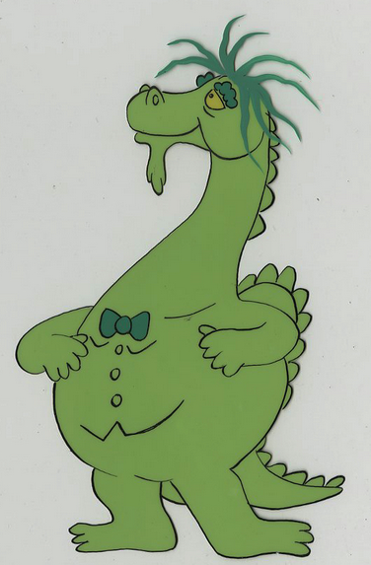
Score:
Q1: You have a Dragon Tattoo? 1
Q2: You love hunting? 1
Q3: What color do you prefer? 2
Q4: What superhero do you prefer? 3
Q5: What would you rather do in your free time? 3
Q6: What type of movie do you like to watch? 4
Q7: What detective show do you prefer? 2
Q8: What Fantasy movie would you prefer to watch? 4
Q9: What type of trait do you prefer? 5
Q10: Where would you prefer to live? 3
Score: [1,1,2,3,3,4,2,4,5,3]
https://vegalleries.com/art/murakami-wolf/5092/puff-the-magic-dragon-1978-1982/puff-the-magic-dragon-model-cel-id-novpuff17446
The lyrics tell a story of the ageless dragon Puff and his playmate, Jackie Paper, a little boy who grows up and loses interest in the imaginary adventures of childhood and leaves Puff to be with himself. The story of the song takes place "by the sea" in the fictional land of "Honalee".
The authors of the song have repeatedly rejected this interpretation and have strongly and consistently denied that they intended any references to drug use.^{[10]} Both Lipton and Yarrow have stated "Puff the Magic Dragon is not about drugs."^{[11]} Yarrow has frequently explained that the song is about the hardships of growing older and has no relationship to drug-taking.^{[12][13]} He has also said of the song that it "never had any meaning other than the obvious one" and is about the "loss of innocence in children",^{[14]} and dismissed the suggestion of association with drugs as "sloppy research".^{[15]}

Slide 10
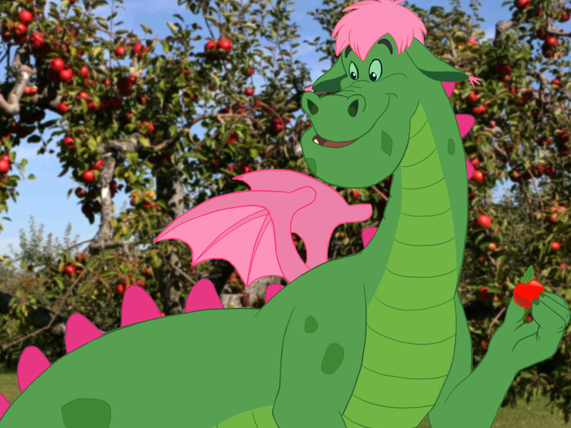
Score:
Q1: You have a Dragon Tattoo? 2
Q2: You love hunting? 1
Q3: What color do you prefer? 1
Q4: What superhero do you prefer? 4
Q5: What would you rather do in your free time? 4
Q6: What type of movie do you like to watch? 1
Q7: What detective show do you prefer? 4
Q8: What Fantasy movie would you prefer to watch? 4
Q9: What type of trait do you prefer? 1
Q10: Where would you prefer to live? 3
Score: [2,1,1,4,4,1,4,4,1,3]
https://www.google.com/imgres?imgurl=http%3A%2F%2Fbehindthelensonline.net%2Fsite%2Fwp-content%2Fuploads%2F2015%2F02%2Fpetes-dragon-1977.jpg&imgrefurl=http%3A%2F%2Fbehindthelensonline.net%2Fsite%2Fnews%2Fprincipal-photography-begins-in-new-zealand-on-petes-dragon%2F&tbnid=3vPE7HzbIxtE3M&vet=12ahUKEwjb_9Cr24PpAhWPRs0KHSGiDRkQMygbegQIARBo..i&docid=tE9LN-n4bex6bM&w=800&h=600&q=petes%20dragon&ved=2ahUKEwjb_9Cr24PpAhWPRs0KHSGiDRkQMygbegQIARBo

Slide 11
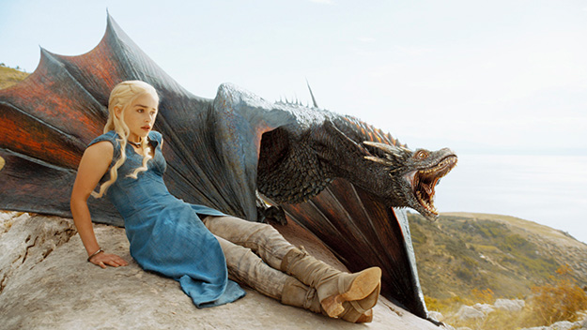
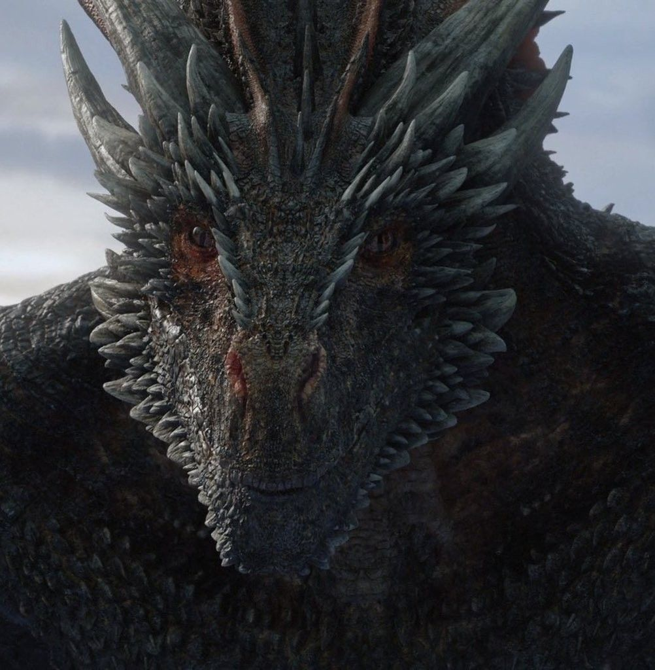
Score:
Q1: You have a Dragon Tattoo? 4
Q2: You love hunting? 5
Q3: What color do you prefer? 4
Q4: What superhero do you prefer? 1
Q5: What would you rather do in your free time? 1
Q6: What type of movie do you like to watch? 1
Q7: What detective show do you prefer? 2
Q8: What Fantasy movie would you prefer to watch? 4
Q9: What type of trait do you prefer? 3
Q10: Where would you prefer to live? 4
Score: [4,5,4,1,1,1,2,4,3,4]
Well literally, "Dracarys" means "Dragonfire" in High Valyrian. It's the word Dany uses to signal to her dragon, Drogon, that she wants him to go all evil-fire-destruction up in this bish
https://www.google.com/url?sa=i&url=https%3A%2F%2Fwww.geek.com%2Ftech%2Fthe-origin-of-the-species-dragons-1661702%2F&psig=AOvVaw1quEqFWYXZVq4c1BvNtbzt&ust=1587908976358000&source=images&cd=vfe&ved=0CAIQjRxqFwoTCJiO8YDjg-kCFQAAAAAdAAAAABAR

Slide 12
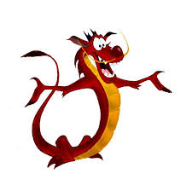
Q1: You have a Dragon Tattoo?
Never
No
Thinking About it
Yes
Have more than 1
Q2: You love hunting
No
Not really
No preference
Maybe
Yes
Q3: What color do you prefer?
Red
Green
White
Blue
Black
Q4: What superhero do you prefer?
Iron Man
Captain America
Snowflake
Wonder Woman
Captain Marvel
Q5: What would you rather do in your free time?
Go for a hike
Curl up on the couch and watch Tv
Work on arts and crafts
Curl up on the couch and read a book
Manage your money
Q1: What type of movie do you like to watch?
Adventure
Suspense
Horror
Romantic Comedy
Comedy
Q2: What detective show do you prefer?
Bones
NCIS
Murder She Wrote
Law and Order
Sherlock
Q3: What Fantasy movie would you prefer to watch?
Harry Potter
The Hobbit
Game of Thrones
Pete’s Dragon
Mulan
Q4: What type of trait do you prefer?
Funny
Intelligent
Protector
Frugal
Free Spirit
Q5: Where would you prefer to live?
Pacific Northwest
Asia
Atlantic Northeast
Europe
Pacific Southwest
Mushu
Score:
Q1: You have a Dragon Tattoo? 1
Q2: You love hunting? 1
Q3: What color do you prefer? 3
Q4: What superhero do you prefer? 5
Q5: What would you rather do in your free time? 4
Q6: What type of movie do you like to watch? 5
Q7: What detective show do you prefer? 2
Q8: What Fantasy movie would you prefer to watch? 5
Q9: What type of trait do you prefer? 1
Q10: Where would you prefer to live? 2
Score: [1,1,3,5,4,5,2,5,1,2]
Personality
Rather selfish at times, overconfident, impulsive, determined, loyal, comical, sassy, caring, tough, charismatic, creative, impatient, protective, sensitive
Appearance
Small and slender red Chinese dragon, blue horns, gold mustache, yellow underbelly, dark red nose, claws, tail tuft and spikes on his back, black eyes

